Slide 1
Learning Objective
I will be able to apply the order of transformation to graphs of functions
Success Criteria
At the end of the lesson, I will be able to:
define the order of transformations as bcad in factored form (i.e. x-dilation, x-translation, y-dilation, y-translation); and
apply the order of transformation to graphs of functions.

Slide 2
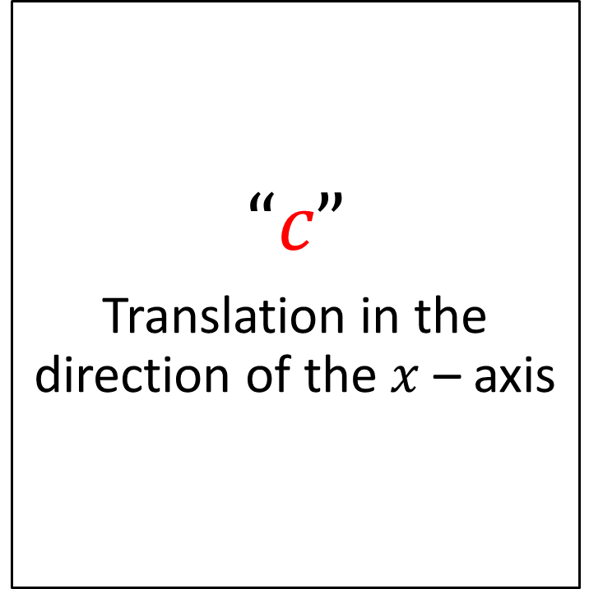
Horizontal Translation
Activating Prior Knowledge
The transformation f(x + c) generalises a horizontal translation, c units.
“If +c, ...in the direction of the negative x-axis” (LEFT)
“If -c, ...in the direction of the positive x-axis” (RIGHT)
$$“c”$$
Translation in the direction of the $x$ – axis

Slide 3
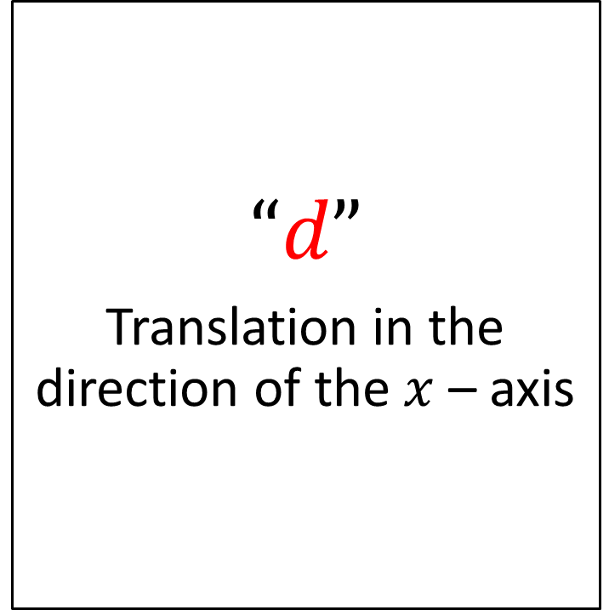
Vertical Translation
Activating Prior Knowledge
The transformation f(x)+d generalises a vertical translation, d units.
“If +d, ...in the direction of the positive y-axis” (UP)
“If -d, ...in the direction of the negative x-axis” (DOWN)
$$“d”$$
Translation in the direction of the $x$ – axis

Slide 4
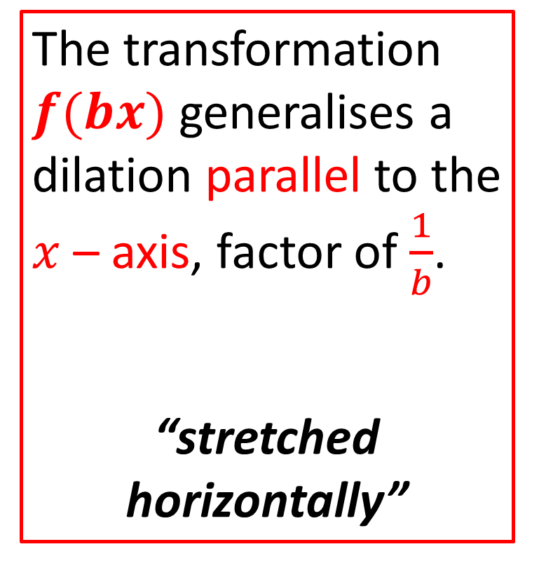
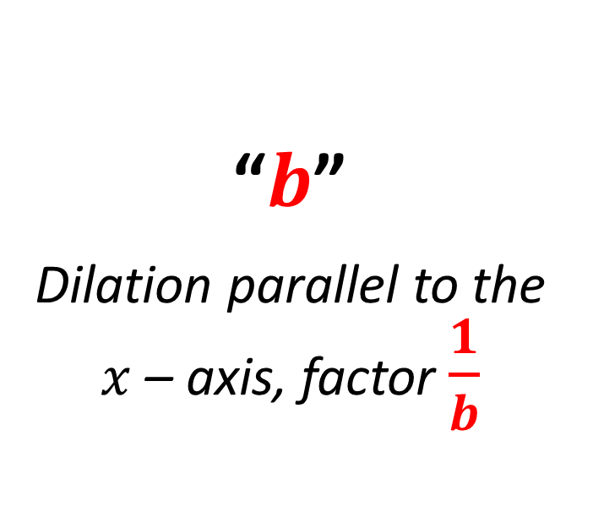
Horizontal Dilation
Activating Prior Knowledge
The transformation $f(bx)$ generalises a dilation parallel to the $x$ – axis, factor of $\frac{1}{b}$.
“stretched horizontally”
“$b$”
Dilation parallel to the $x$ – axis, factor $\frac{1}{b}$

Slide 5
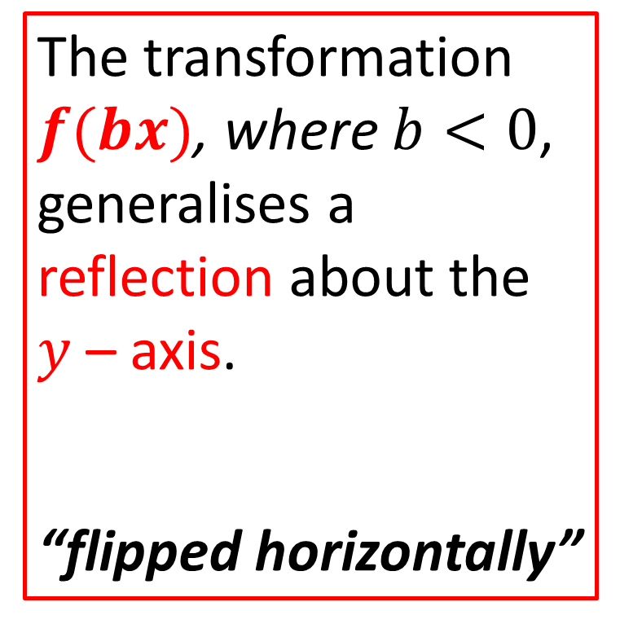
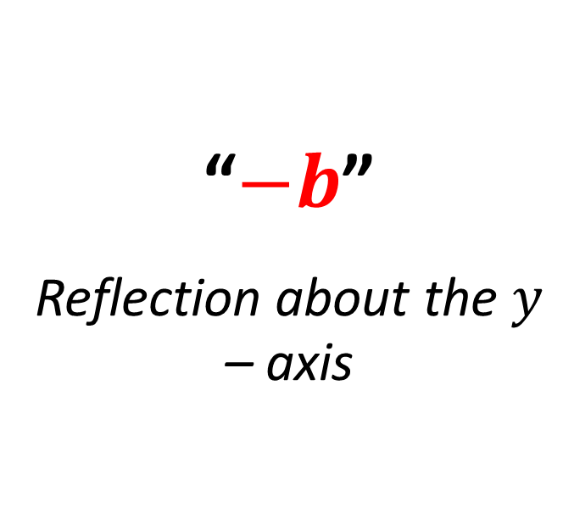
Horizontal Reflection
Activating Prior Knowledge
The transformation $f(bx)$, where $b<0$, generalises a reflection about the $y$ – axis.
“flipped horizontally”
“$−b$”
Reflection about the $y$ – axis

Slide 6
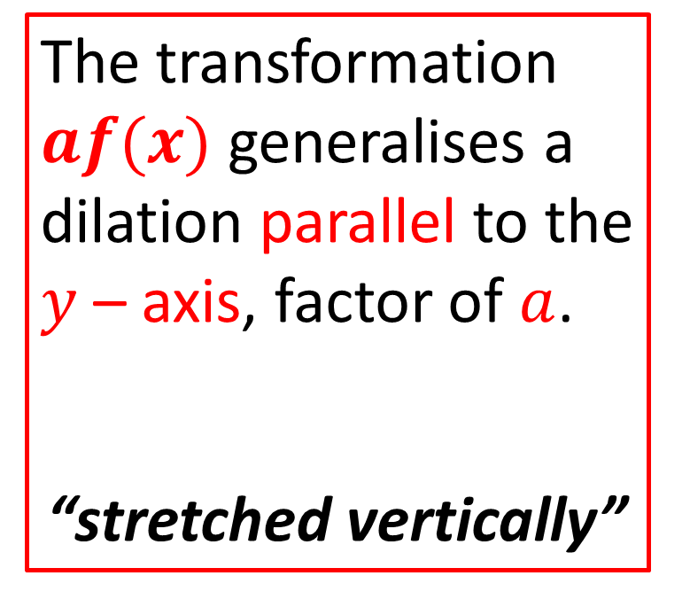
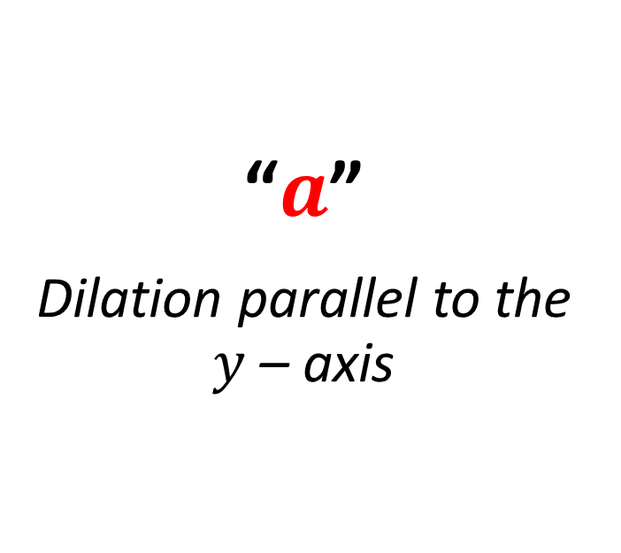
Vertical Dilation
Activating Prior Knowledge
The transformation $af(x)$ generalises a dilation parallel to the $y$ – axis, factor of $a$.
“stretched vertically”
“$a$”
Dilation parallel to the $y$ – axis

Slide 7
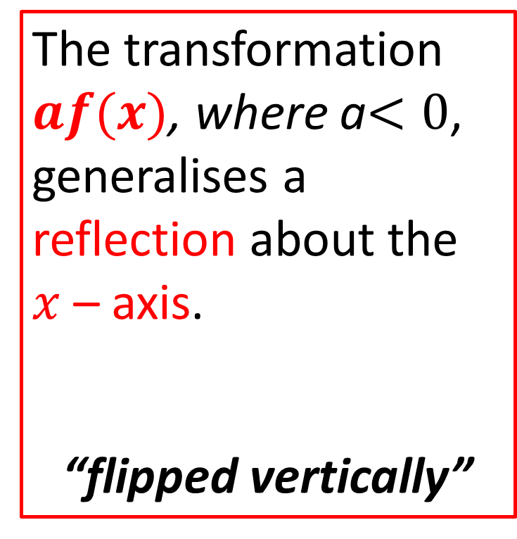
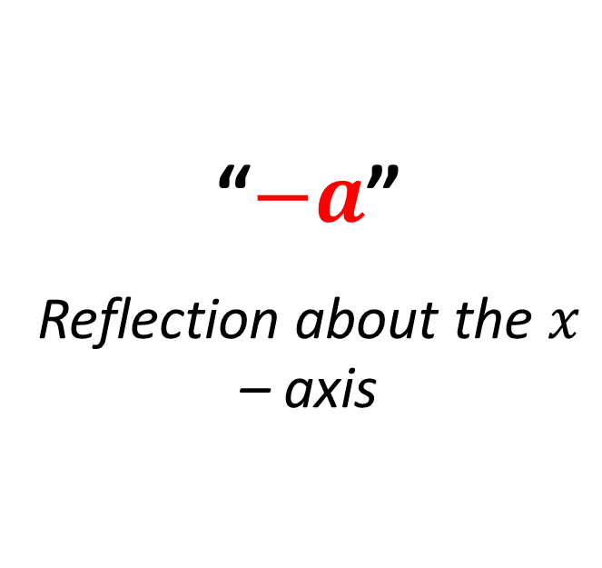
Vertical Reflection
Activating Prior Knowledge
The transformation $af(x)$, where a$<0$, generalises a reflection about the $x$ – axis.
“flipped vertically”
“$−a$”
Reflection about the $x$ – axis

Slide 8
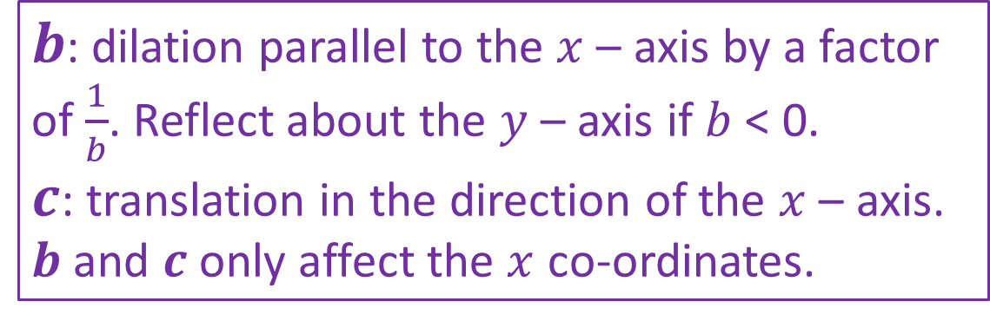

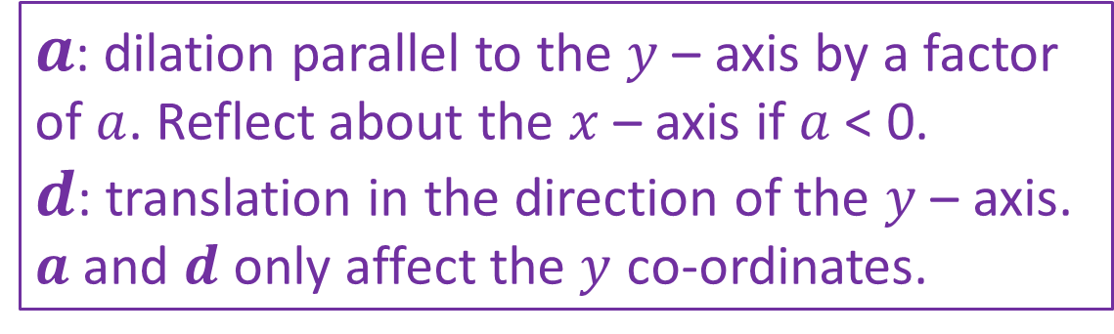
$$f\left(x\right)→af(b\left(x±c\right))±d$$
$b$: dilation parallel to the $x$ – axis by a factor of $\frac{1}{b}$. Reflect about the $y$ – axis if $b$ < 0.
$c$: translation in the direction of the $x$ – axis.
$b$ and $c$ only affect the $x$ co-ordinates.
$a$: dilation parallel to the $y$ – axis by a factor of $a$. Reflect about the $x$ – axis if $a$ < 0.
$d$: translation in the direction of the $y$ – axis.
$a$ and $d$ only affect the $y$ co-ordinates.

Slide 9
Concept Development
Describe the order of transformation from $f\left(x\right)→2f\left(3\left(x−1\right)\right)+1$
3: Dilation parallel to the $x−$axis by a factor of $\frac{1}{3}$
-1: Translated horizontally to the right by $1$ unit
2: Dilation parallel to the $y−$axis by a factor of 2
+1: Translated vertically upwards by $1$ unit

Slide 10

Concept Development
Describe the order of transformation from $f\left(x\right)→3f\left(−2x+4\right)−1$
$$3f\left(−2\left(x−2\right)\right)−1$$
-2: Reflected about the $y−$axis and dilation parallel to the $x−$axis by a factor of $\frac{1}{2}$
-2: Translated horizontally to the right by $2$ unit
3: Dilation parallel to the $y−$axis by a factor of 3
-1: Translated vertically downwards by $1$ unit

Slide 11
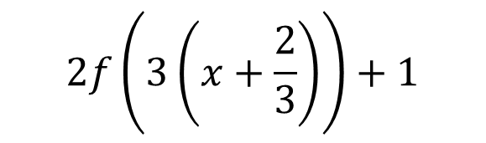
Concept Development
Describe the order of transformation from $f\left(x\right)→2f\left(3x+2\right)+1$
$$2f\left(3\left(x+\frac{2}{3}\right)\right)+1$$
3: dilation parallel to the $x−$axis by a factor of $\frac{1}{3}$
$\frac{2}{3}$: Translated horizontally to the left by $\frac{2}{3}$ unit
2: Dilation parallel to the $y−$axis by a factor of 2
+1: Translated vertically upwards by $1$ unit

Slide 12

Guided Practice
Find the rule for the image of the graph $y=f(x)$ under the following transformation
$f\left(x\right)=\sqrt{x}$ under a translation of 2 units in the positive direction of the $x−$ axis followed by a dilation factor of $3$ from the $x−$ axis

Slide 13

Guided Practice
Find the rule for the image of the graph $y=f(x)$ under the following transformation
$f\left(x\right)=\sqrt{x}$ under a reflection in the $x−$ axis followed by a dilation factor of $2$ from the $y−$ axis

Slide 14

Guided Practice
Find the rule for the image of the graph $y=f(x)$ under the following transformation
$f\left(x\right)=\sqrt{x}$ a dilation of factor of 2 from the $y−$ axis followed by a translation of 3 units in the negative direction of the $x−$ axis and 3 units in the negative direction of the $y−$ axis

Slide 15

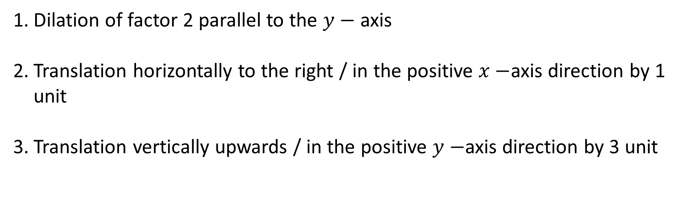
Guided Practice
Determine the sequence of transformation that taks the graph of $y=x^{2}$ to the graph $y=2{\left(x−1\right)}^{2}+3$
Dilation of factor 2 parallel to the $y−$ axis
Translation horizontally to the right / in the positive $x−$axis direction by 1 unit
Translation vertically upwards / in the positive $y−$axis direction by 3 unit

Slide 16

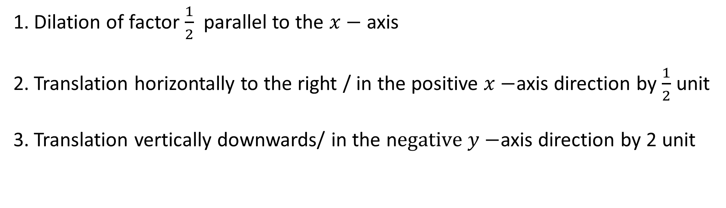
Guided Practice
Determine the sequence of transformation that taks the graph of $y=x^{2}$ to the graph $y={\left(2x−1\right)}^{2}−2$
Dilation of factor $\frac{1}{2}$ parallel to the $x−$ axis
Translation horizontally to the right / in the positive $x−$axis direction by $\frac{1}{2}$ unit
Translation vertically downwards/ in the n$egative y−$axis direction by 2 unit

Slide 17

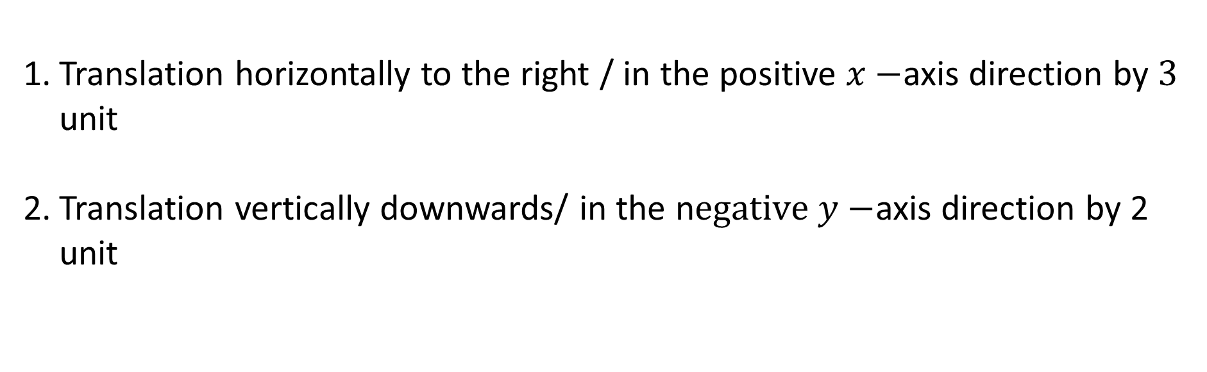
Guided Practice
Determine the sequence of transformation that taks the graph of $y=\frac{1}{x}$ to the graph $y=\frac{1}{x−3}−2$
Translation horizontally to the right / in the positive $x−$axis direction by $3$ unit
Translation vertically downwards/ in the n$egative y−$axis direction by 2 unit

Slide 18
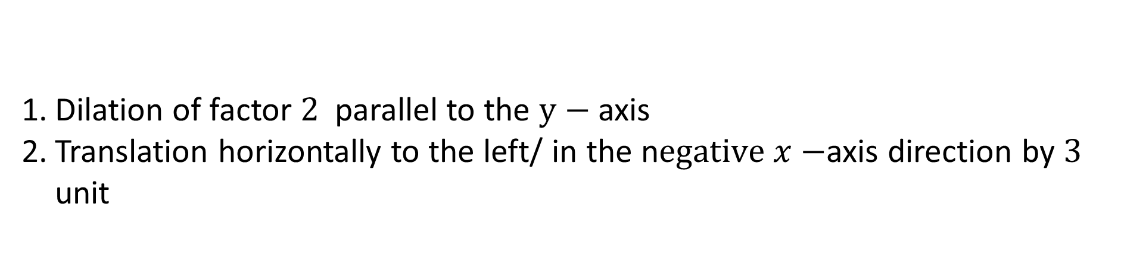

Guided Practice
Determine the sequence of transformation that taks the graph of $y=\frac{1}{x}$ to the graph $y=\frac{2}{x+3}$
Dilation of factor $2$ parallel to the $y−$ axis
Translation horizontally to the left/ in the n$egative x−$axis direction by $3$ unit

Slide 19
Independent Practice
Complete Cambridge Ex 6H&I

